Slide 1
Food From Waste: Conversion of Organic Waste Substrates into Gourmet Edible and Medicinal Mushrooms in Washington
H. Hurt, Plant Pathology
4/13/2022

Slide 2
Background:
Edible Mushroom production in the US is concentrated in a few large farms.
Small businesses accounted for less than 10% of production in 2017 (Mushrooms Profile 2018).
This leads to a relative lack of research on cultivation techniques for many species.
Low utility of organic waste
Transportation costs limit economic use of organic waste products (Bluffington 2014).
Major limit on biofuel development

Slide 3
Background:
While it is known which mushroom species grow best on which substrates in general, there does not seem to be research directly linking this knowledge to fruiting body yields or cultivation techniques.
This knowledge is essential when deciding whether to cultivate mushrooms.

Slide 4
Motivation:
Optimal cultivation parameters for many edible mushroom species have yet to be rigorously studied.
Redirecting organic waste streams to mushroom substrates is a potential way to repurpose it and increase economic value.

Slide 5
Objectives:
Identify mushroom species x substrate combinations that are well suited for cultivation in the Pacific Northwest
Determine economic viability of using the combinations tested
Input costs, market prices, labor, equipment

Slide 6
Two Experiments:
Sporocarp production:
Measure as a function of selected species and substrates
Null Hypothesis: All species generate the same sporocarp biomass in each substrate.
Gain Spawn:
Can brewer’s spent grain (BSG) be used to propagate fungal cultures?
Null Hypothesis: There are no significant difference in mycelium growth rate between cultures grown on BSG and wheat berries.

Slide 7
Species Collected:
Species:
Common Name | Latin Name | Location
Prince Agaricus | Agaricus augustus | Whitman County, WA
Horse Mushroom | Agaricus arvensis | Whitman County, WA
Shaggy Mane | Coprinus comatus | Whitman County, WA
Artist's Conk | Ganoderma applanatum
Bear's Head | Hericium americanum | Bonner County, ID
Oyster Mushroom | Pleurotus ostreatus | Hoh Rainforest, Olympic National Park WA
Winecap | SRUG1 - Stropharia rugoso-annulata | Retailer - Mushroom Mtn. NC
Shiitake | LEDO2 - Lentinula edodes - Cold Outdoor | Retailer - Mushroom Mtn. NC
Wood-ear | AAUR1 - Auricularia auricula - Wood Ear - Wild type, SC | Retailer - Mushroom Mtn. NC

Slide 8
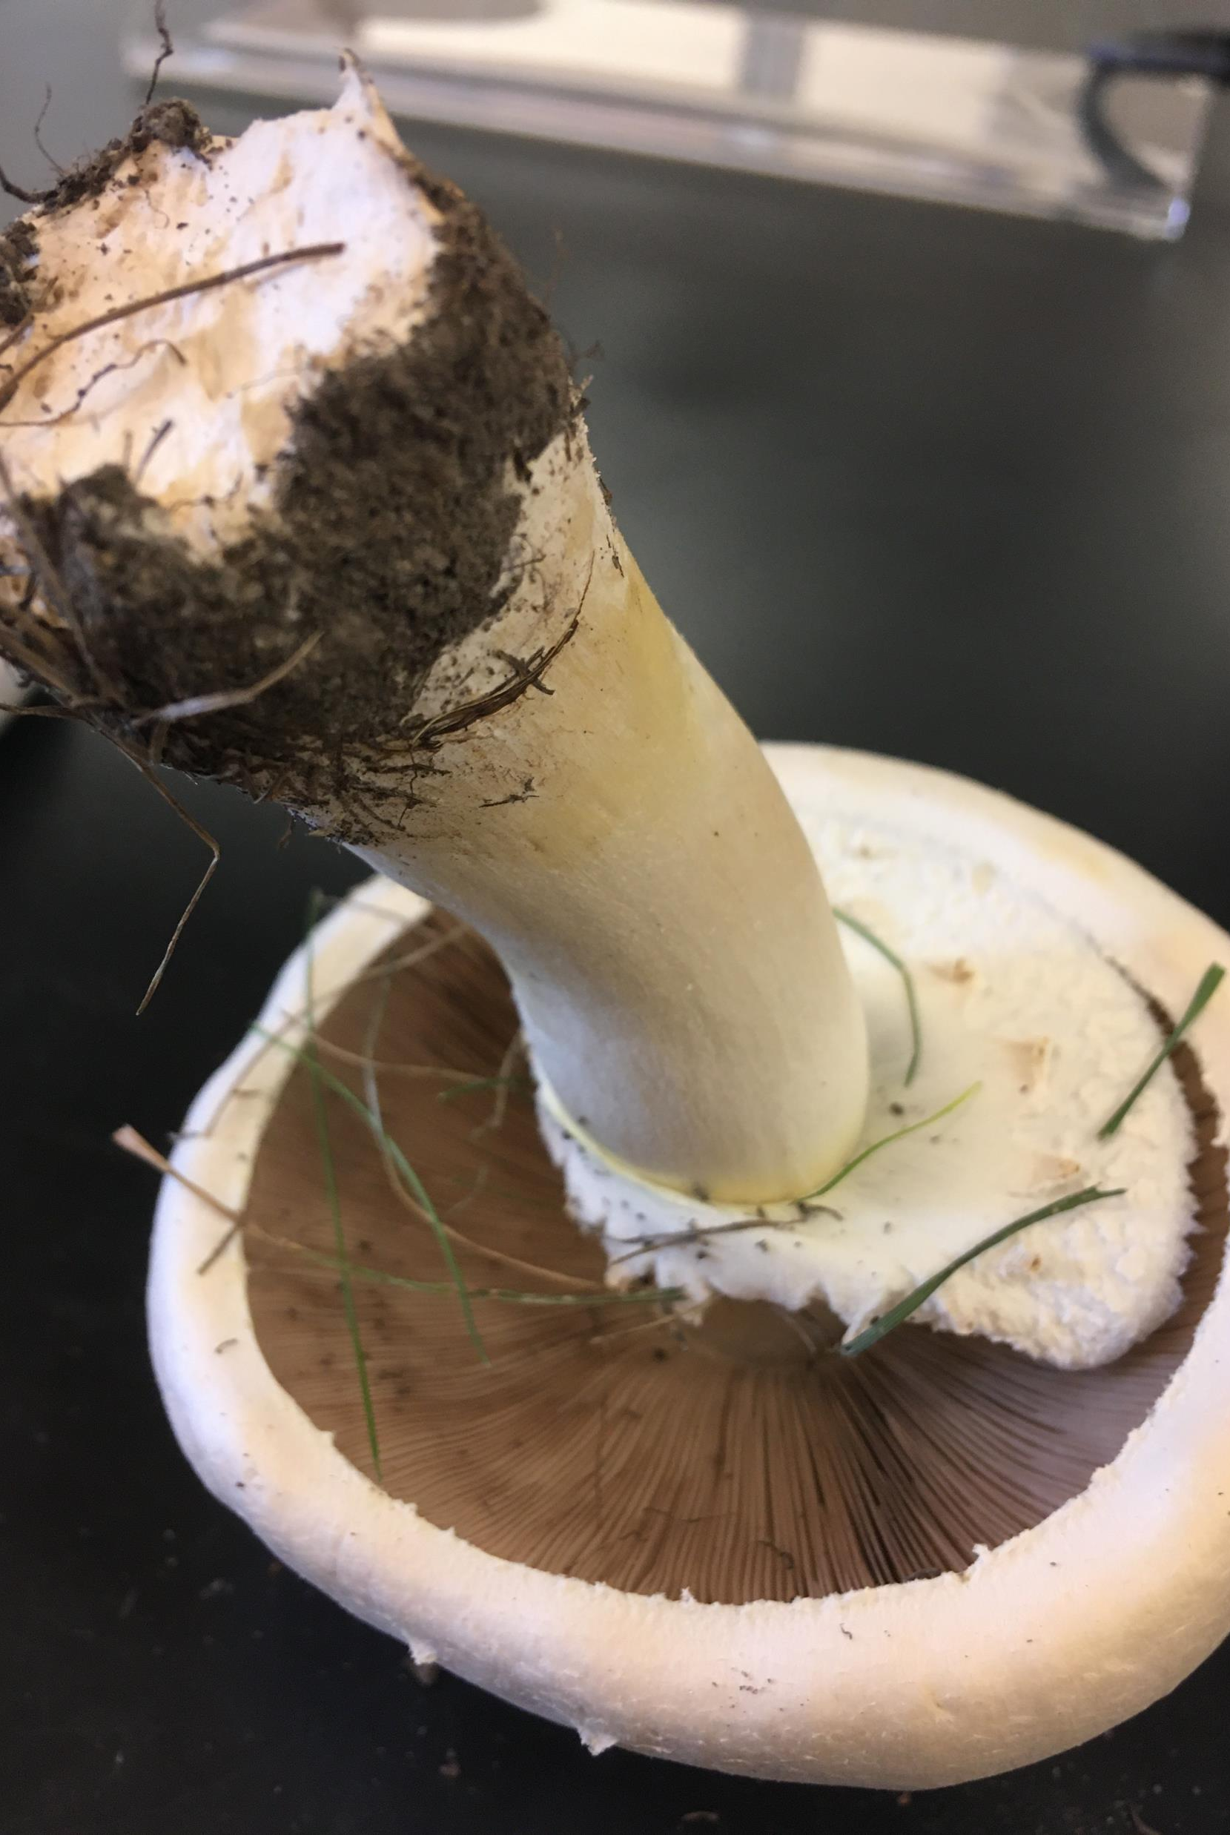
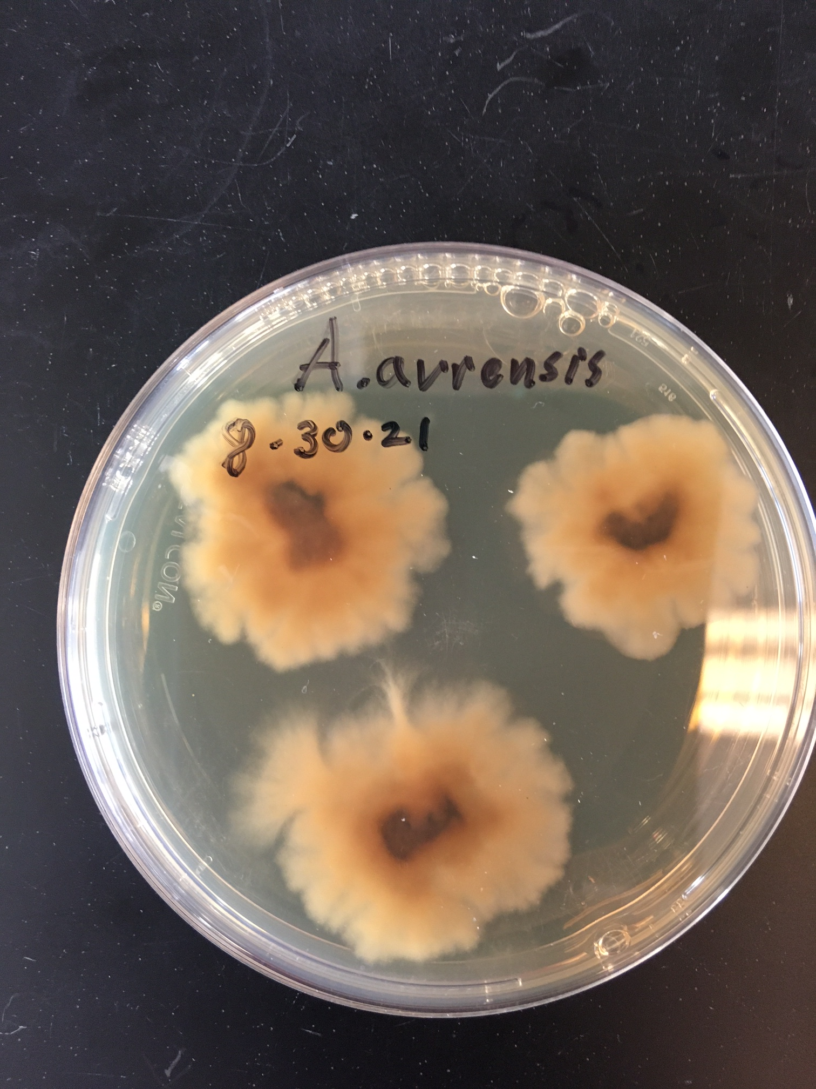
Agaricus arvensis

Slide 9
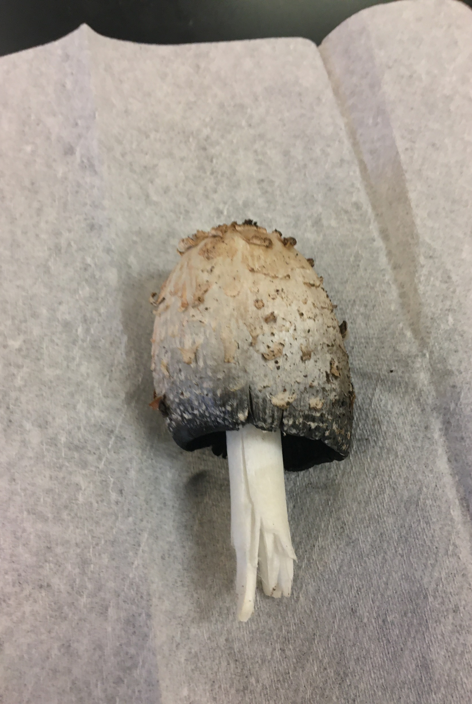
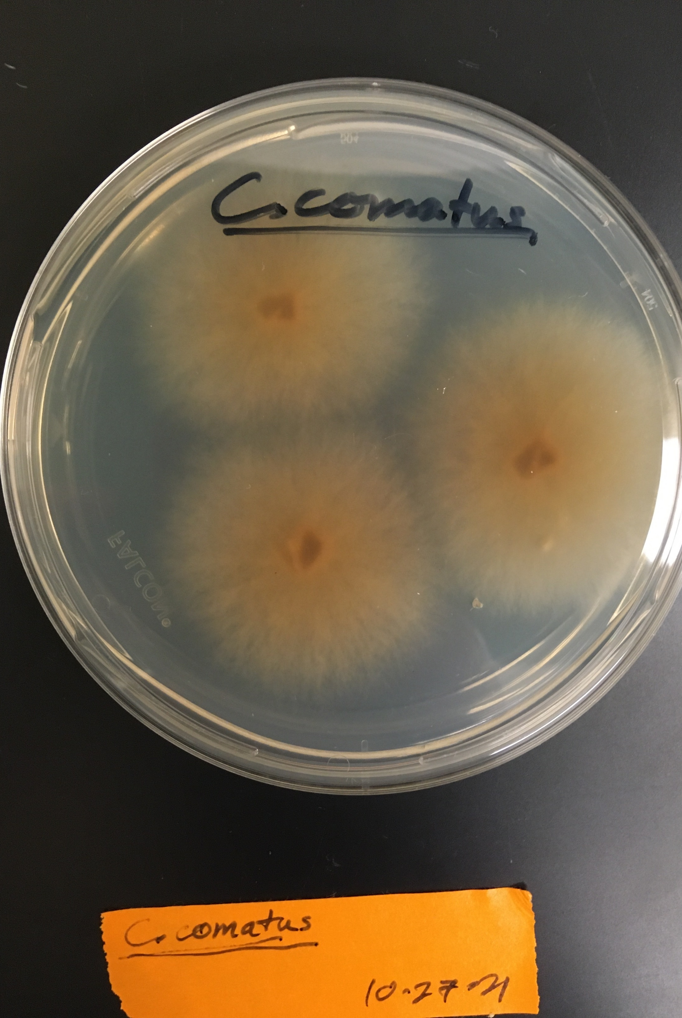
Coprinus comatus

Slide 10
Experimental Design:
9 Species x 5 Treatments x10 Replicates

Slide 11
Substrate Sources:
Sawdust – ponderosa pine
Bennett Lumber Co., Clarkston WA
Straw
Four Star Supply, Pullman WA
Brewer’s Spent Grain (BSG)
Another Round Brewing, Pullman WA
Coffee Grounds
Pups and Cups Coffee Pullman, WA

Slide 12
Amount of Substrates:

Slide 13
Methods and Materials:
Collect and culture samples in lab:
Confirm species through DNA sequencing
Grain Spawn:
Generating vigorous grain spawn helps speed up inoculation of bulk substrate.
Treat Substrates:
Pine sawdust must be fermented before use
Pasteurize all substrates

Slide 14
Methods and Materials: Grain Spawn
Compare growth on BSG vs. wheat berries for all 9 species
2 units of each substrate will be produced for each species
Water content = 50%
Weight = 2 kg each
36 experimental units
Once optimal substrate is determined, 4.5 kg of grain spawn will be produced for each species to use inoculate bulk substrate.

Slide 15
Methods and Materials: Sporocarps
Growth Bags:
Water content = 65 - 70 % by weight
Weight = 3 kg
Inoculate 5% by weight
450 experimental units
Growing Conditions:
The environment will be adjusted depending on the growth stage.
Humidity, temperature, light

Slide 16
Methods and Materials:
Casing Soil:
Some species (A. augustus, A. Arvensis, and S. rugoso-annulata) will have a layer of casing soil applied.
Data Collection:
Sporocarps will be harvested at maturity and measured.
Repeated flushes of mushrooms will be collected during the summer and fall.
Each flush will be compared separately.

Slide 17
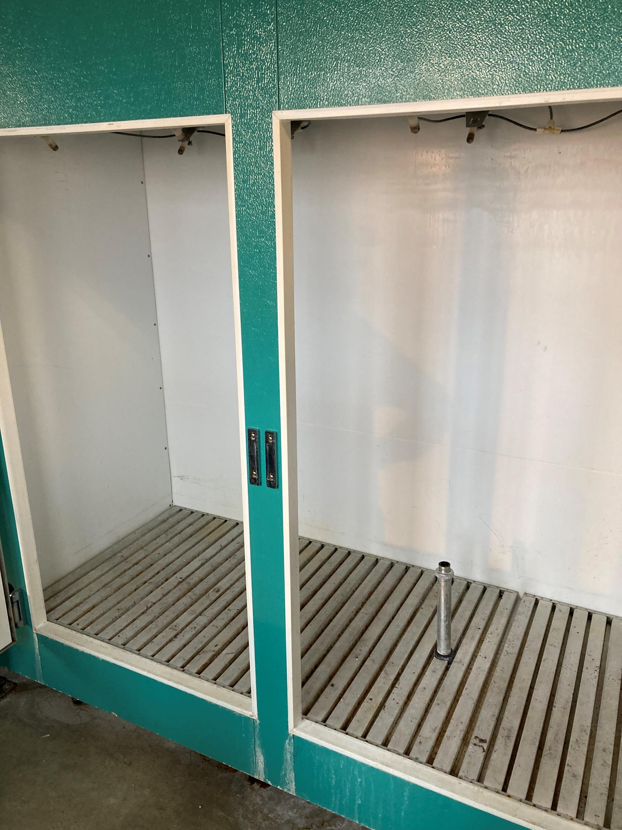
Greenhouse Growth Chambers

Slide 18
Outcomes:
Grain Spawn:
Mycelium growth rate
Contamination
Sporocarp Production:
Fresh weight
Dry weight
Size/dimensions
Biological effeciency

Slide 19
Timeline:
Month: | Main Tasks:
April | Conduct grain spawn experiment
 | Set up growth chamber (when available)
 | Treat Sawdust
May | Assemble experimental units
 | Start cultivation in growth chambers
 | Narrow list of journals to potentially publish in
June | Continue Cultivation
 | Collect data on repeated flushes
 | Edit paper into journal format
 | Contact potential stakeholders about holding workshops
July | Continue Cultivation
 | Contact journals about publication

Slide 20
Growth Schedule

Slide 21
Potential Journals:
Several scientific journals that specialize in mycological and agricultural research have been identified as potential publishing destinations.
Mycosphere
Bioresource Technology
Acta Mycologica
LTW – Food Science and Technology
Applied Microbiology & Biotechnology
Compost Science & Utilization

Slide 22
Deliverables:
Side-by-side comparison of sporocarp production depending on species and substates
Economic analysis for cultivating each species
Information needed to determine if the selected mushroom species can be successfully cultivated in Eastern Washington

Slide 23
Summary: Progress so far
All species collected
Research space
Greenhouse and growth chamber space is being obtained this week. (4/11/22)
Methods & Materials
Sources for substrates identified and contacted
Some of all substrates have been obtained, waiting until space is available before acquiring more

Slide 24
Summary: Ongoing
DNA sequencing of wild samples
Treatment of substrates
Sawdust must be composted before it can be used.
Others must be dried
Generating grain spawn
Should take 2-3 weeks.

Slide 25
Coursework

Slide 26
Program of Study
List credit requirements.
Screenshot of doc.
Bring document to sign.
List options for courses
525
570
both

Slide 27
Credit Requirements:
Degree Credit Requirements:
Total: | 30
Courses: | 21
500 level or above (min): | 15
400 or less (max): | 6
Research, 700 level: | 15
Credits per Semester: | 10

Slide 28
Courses to Date:
Semester | Course Number | Title | Credits | Credits from Research:
Fall 2021 | PLP 429 | General Plant Pathology | 3
Fall 2021 | PLP 521 | General Mycology | 3
Fall 2021 | PLP 700 | Masters Research, Thesis, Exam | 1 | 1
Fall 2021 | STAT 511 | Stat Methods for Grad Research | 4
Spring 2022 | STAT 530 | Predictive Models | 3
Spring 2022 | SOIL 514 | Environmental Biophysics | 2
Spring 2022 | PLP 515 | Department Seminar | 1
Spring 2022 | PLP 700 | Masters Research, Thesis, Exam | 4 | 4

Slide 29
Courses to Date:
Semester | Course Number | Title | Course Credits | Credits from Research
Fall 2021 | PLP 429 | General Plant Pathology | 3
Fall 2021 | PLP 521 | General Mycology | 3
Fall 2021 | PLP 700 | Masters Research, Thesis, Exam | 0 | 1
Fall 2021 | STAT 511 | Stat Methods for Grad Research | 4
Spring 2022 | STAT 530 | Predictive Models | 3
Spring 2022 | SOIL 514 | Environmental Biophysics (+ lab) | 3
Spring 2022 | PLP 515 | Department Seminar | 1
Spring 2022 | PLP 700 | Masters Research, Thesis, Exam | 0 | 4

Slide 30
Future Courses:
Semester | Course Number | Title | Course Credits | Credits from Research
Summer 2022 | PLP 525 | Field Plant Pathology and Mycology | 3
* | * | * | *
Fall 2022 | PLP 700 | Masters Research, Thesis, Exam | 0 | *
Spring 2023 | PLP 570 | Techniques in Plant Pathology | 3
Spring 2023 | PLP 700 | Masters Research, Thesis, Exam | 0 | 7

Slide 31
Potential Courses:
Semester | Course Number | Title | Course Credits
Fall 2022 | PLP 503 | Advanced Cropping Systems | 3
Fall 2022 | PLP 514 | Phytobacteriology | 3
Fall 2022 | PLP 570 | Techniques in Plant Pathology | 3
Fall 2022 | SOIL 531 | Soil Microbiology | 3
Spring 2023 | PLP 551 | Epidemiology and Mgmt. of Plant Diseases | 3
Spring 2023 | PLP 512 | Topics in Plant Pathology | 1,3

Slide 32
Questions:
How often should I submit progress reports?
How often should we have meetings?
How will the summer be different academically?
What if I can’t get growth chambers for the whole time?

Slide 33
Revised Methods Document
Send out link in advance.
Links:
Slides
Methods
Github repo
Progress reports
Calendar

Slide 34
Last Meetings Comments
Lab notebook
Collecting isolates
Extracting DNA
Revised "Lab Calendar" document
Bring a copy
List of needed resources and sources
Strong revision and addition to "Methods" document
List of deliverables at different time scales
Classes for rest of school
Summer courses

Slide 35
Sources:
Buffington, J. (2014). The economic potential of brewer’s spent grain (BSG) as a biomass feedstock. Advances in Chemical Engineering and Science, 2014.
“Mushrooms Profile.” (2018). Agricultural Marketing Resource Center. Retrieved Sept. 24th, 2021. https://www.agmrc.org/commodities-products/specialty-crops/mushrooms-profile
Royse, D.J., Baars, J. and Tan, Q. (2017). Current Overview of Mushroom Production in the World. In Edible and Medicinal Mushrooms (eds C.Z. Diego and A. Pardo-Giménez). https://doi.org/10.1002/9781119149446.ch2
Zięba, P., Sękara, A., Sułkowska-Ziaja, K., & Muszyńska, B. (2020). Culinary and Medicinal Mushrooms: Insight into Growing Technologies. Acta Mycologica, 55(2), 1–19.

